Slide 1
Once upon a time there lived a fossil ……..!?
Phylum
Arthropoda
5 SUBPHYLA:
1hylTrilobitmorpha
2hylCrustacea
3hylChelicerata
4 Myriapoda (Diplopoda & Chilopoda)
5 Hexapoda (Insecta)

Slide 2
Phylum
Arthropoda
Subphylum 2 Crustacea
Class Copepoda
Class Cirripedia
Class Malacostraca
Class Ostracoda
Class Branchiopoda
(Send your e-mails ‘CC MOB’) or
‘B O CC M’
(Head of the mob!)

Slide 3
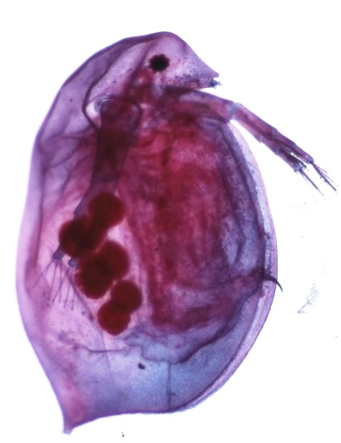
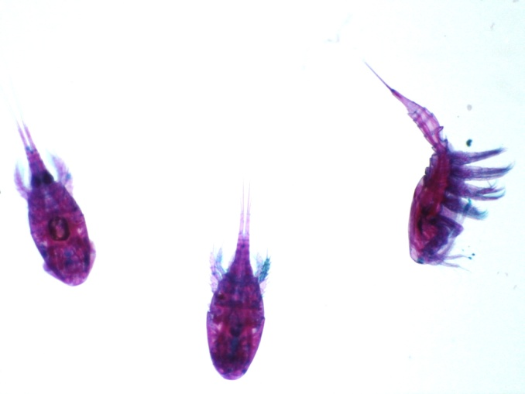
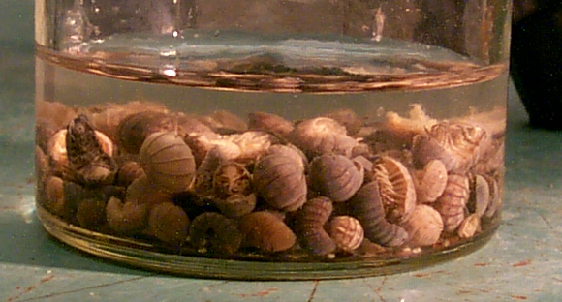
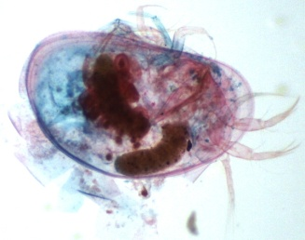
Subphylum 2
Crustacea
Class Cirripedia
Class Branchiopoda
Acorn & Stalked Barnacles
“Lung feet”
Fairy Shrimp
Daphnia
Class Malacostraca
= Largest class
4 ORDERS
Do not need to know the names of these Orders for the practical! S.A.I.D. – just note that A & B are closely related.
Stomatopoda
Mantis Shrimp
Amphipoda
Beach Hoppers &
Sand Fleas
Isopoda B
Pill bugs
Giant Sea Roach
Decapoda A
Crabs, Lobsters etc..
Class Copepoda
A
Tiny red-eyed aliens! Really weird looking
Class Ostracoda
B
Seed shrimp with bivalve-like shell

Slide 4
periopods
pleopods
Crayfish - 1st pleopod in males = specialized intromissive organ. Absent or reduced in females.
Cheliped = an appendage bearing a chela or claw
Help! I’ve fallen and I can’t get up!
Subphylum 2 Crustacea
Class Malacostraca
Order Decapoda

Slide 5
Phylum
Arthropoda
Subphylum 3
Chelicerata
“the literate Chelicerates”
Class Pycnogonida
Class Arachnida
Class Merostomata
‘PAM’ ! ‘AMP’ or
‘MAP’

Slide 6
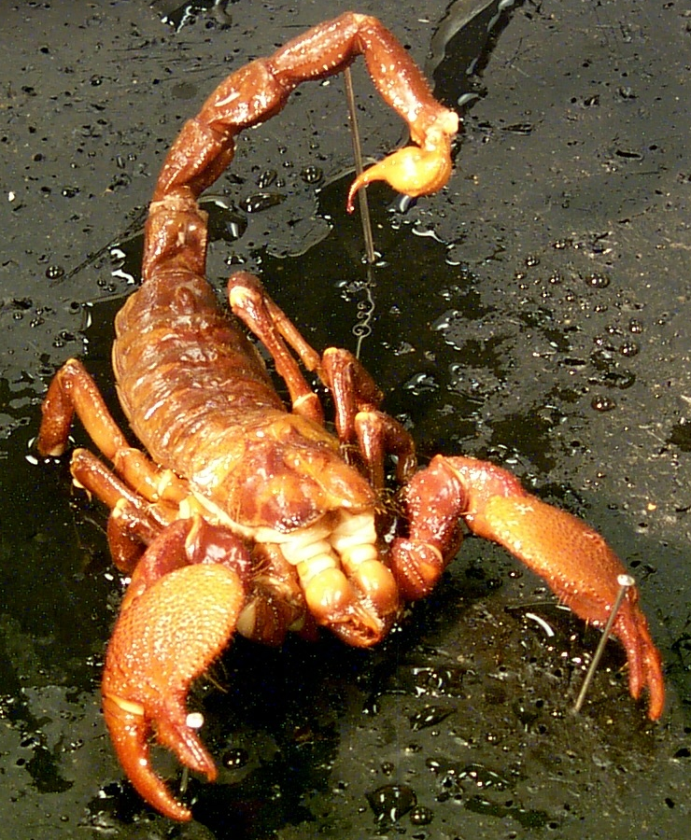
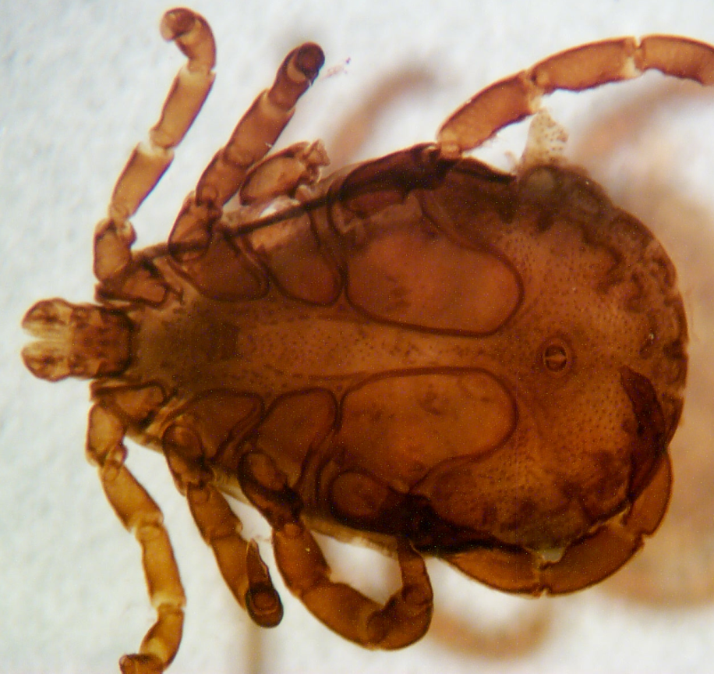
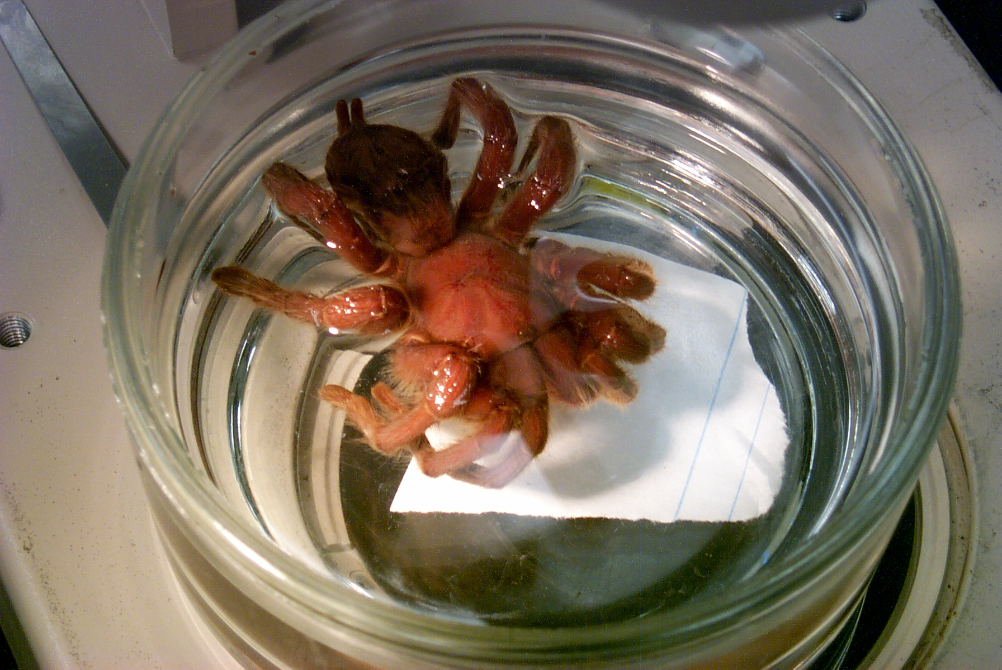
Chela of cheliped
fanged chelicera – to bite and suck blood
Book lungs & spiracles
Fang =
Chelicera
Subphylum 3
Chelicerata
Arachnida

Slide 7
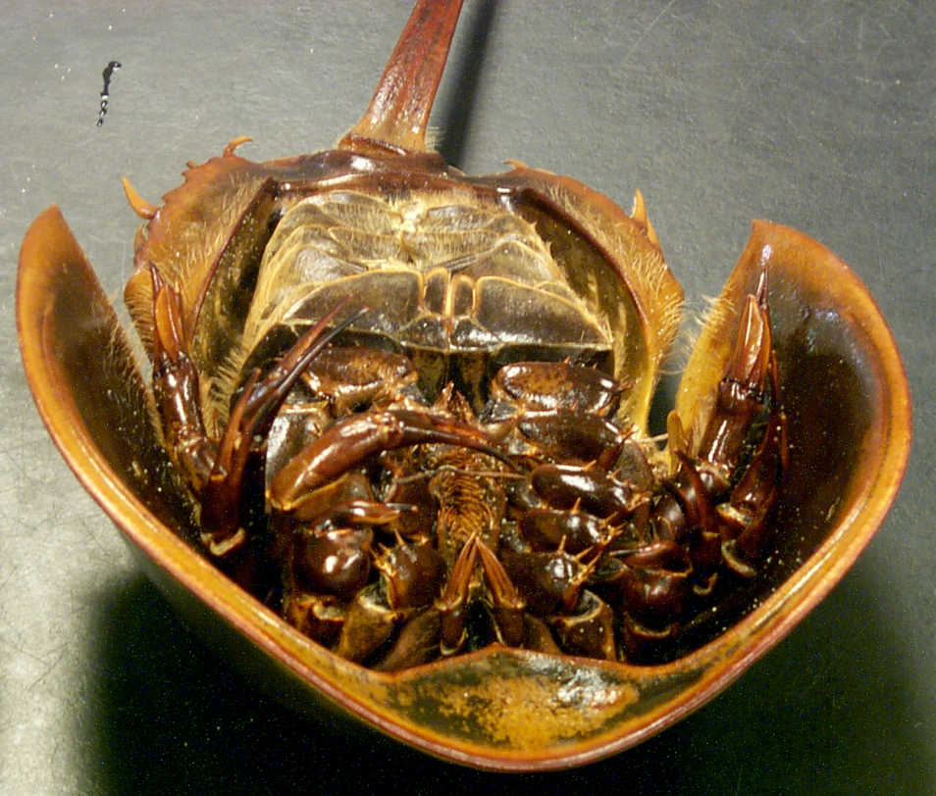
Class:
Merostomata
Book gills
Males clasps females with their 1st periopods = pedipalp.
In the males this is much enlarged to form a boxing glove. In females the 1st periopod or pedipalp is just a regular walking leg.
Chelicera = modified here as a claw

Slide 8
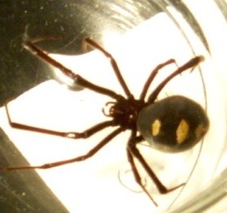
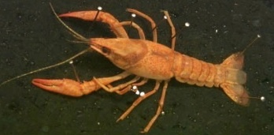
TAGMOSIS
Book lungs/B. gills & tracheal system
Chelicerata
Crustacea
Cephalothorax Abdomen
Crustacea belong to the mob, they’ve been punched in their nose so gills do the job.
Prosoma Opisthosoma
Gills only
(Cephalothorax) (Abdomen)

Slide 9
Phylum
Arthropoda
Subphylum
Myriapoda
‘DIC’ or ‘CID’
Class Chilopoda
Class Diplopoda
Which one has most legs per segment?

Slide 10
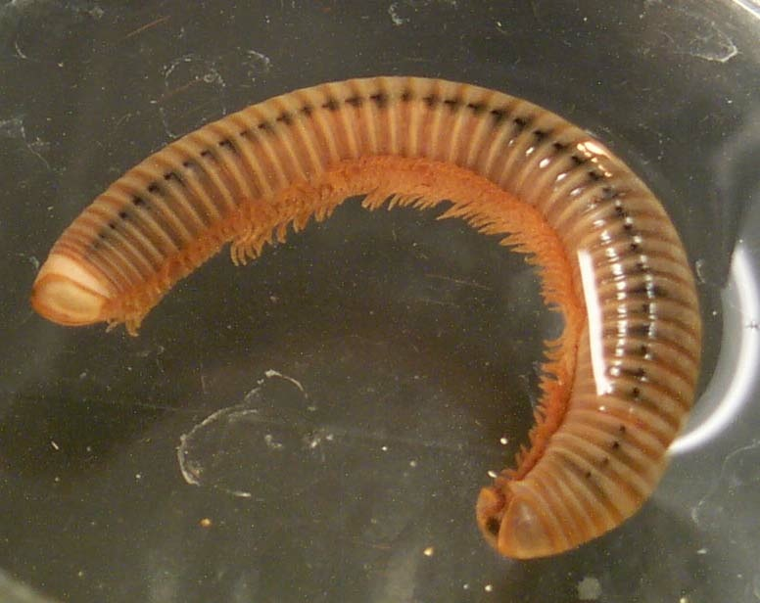
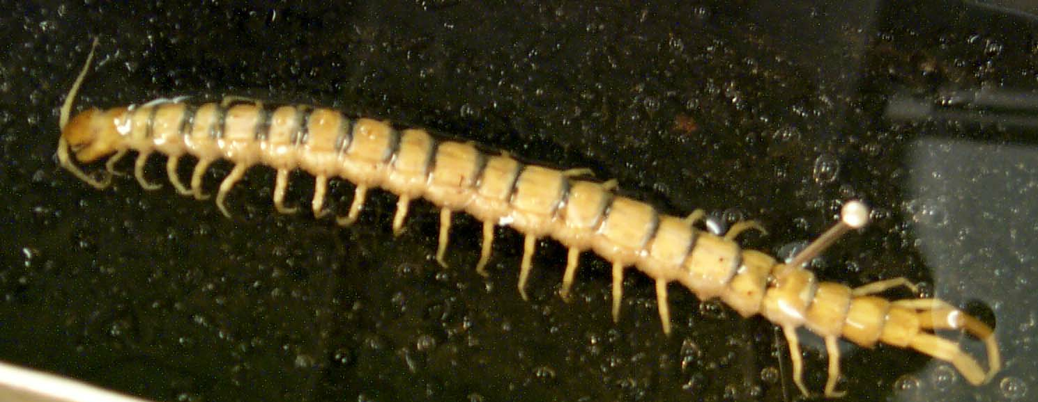
Subphylum 4
Myriapoda
Class Diplopoda
2 pairs of legs/segment
Rounded head with no obvious jaws as it is a deposit feeder
Class Chilopoda
1pair of legs/segment
Vicious jaws of a
carnivorous predator

Slide 11
Just to clarify…..
Phylum Arthropoda
Subphylum Hexapoda
Class Insecta
Subclasses Apterygota (no wings)
Pterygota (winged)
From the lab manual chart
Divisions
Exopterygota
Endopterygota
Orders
O.H.H.I.O.
C.H.i L.D.

Slide 12
Phylum
Arthropoda
Subphylum Class
Hexapoda Insecta
Orders ‘OHHIO’ & ‘CHiLD’
Order Orthoptera Order Coleoptera
Order Hemiptera Order Hymenoptera
Order Homoptera Order Lepidoptera
Order Isoptera Order Diptera
Order Odonata

Slide 13
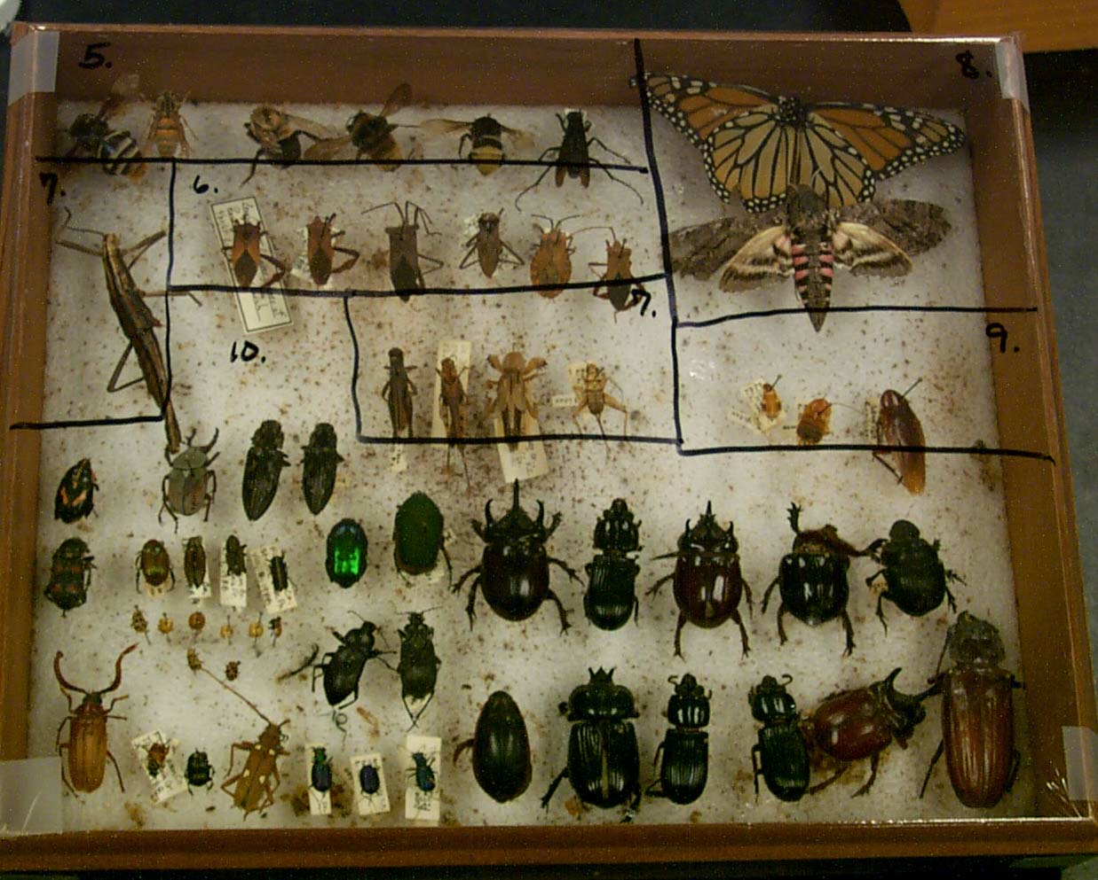
Suphylum 5 Hexapoda Class Insecta
The “bugs!”
Ah! The smell of mothballs!

Slide 14
Metamorphosis is the change
from a LARVAL form to…… an ADULT form
…which grows by MOLTING
..but does NOT REPRODUCE
..which does not grow (MOLT)
..but does REPRODUCE
=

Slide 15
Their wings have completely
G T G
HOLOMETABOLISM
T T U
T

Slide 16
Holometabolism
Holometabola = Endopterygota
4 ORDERS
Egg -> larvae -> pupa -> adult
Aquatic nymph

Slide 17
Holometabolism
4 ORDERS
Wings on the INSIDE in the larva and must undergo a complete metamorphosis to bring them out in the adult. This is a VERY dramatic change

Slide 18
Division Endopterygota:
Holometabolous Life Cycle 4 ORDERS:
Order Hymenoptera
Bees, ants, wasps
Order Lepidoptera
Butterflies, moths
CHiLD = Bugs for decorating a nursery or a children’s picture book.
Order
Coleoptera
True Beetles.
Look for “T” formed by ELYTRA
Order
Diptera
True flies
Look for HALTERES

Slide 19
Hemimetabolism
5 ORDERS
Wings on the OUTSIDE in the larva already. Only need an incomplete/partial metamorphosis
= (using half of the effort)
to bring the insect to the mature adult stage.

Slide 20
Their wings are already out
W
HEMIMETABOLISM
N L U
G R T
S E
A
D
Y

Slide 21
Hemimetabolism
Incomplete metamorphosis Wings on the outside
Hemimetabola = Exopterygota
5 ORDERS
egg-> nymph(mini adult)-> adult
(Naiad if aquatic)

Slide 22
Division Exopterygota:
Hemimetabolous Life Cycle 5 ORDERS:
Order
Odonata
Order
Hemiptera
Dragonflies, damselflies
Bug allies (assassin bugs, bedbugs)
Look for “X” on back
formed by wings
crossing over each
Other. True bugs.
O
H
H
I
O
Order
Homoptera
(cicadas, aphids)
Order
Isoptera
Look for “home” formed by
Termites
wings over back of insect
Order
Orthoptera
Crickets, grasshoppers,
Roaches & mantids
Head-on

Slide 23
Subphylum 5 Hexapoda Class Insecta

Slide 24
Subphylum 5 Hexapoda Class Insecta
Lepidoptera
Hymenoptera
X
7, 9 Orthoptera
6 Hemiptera
Coleoptera

Slide 25
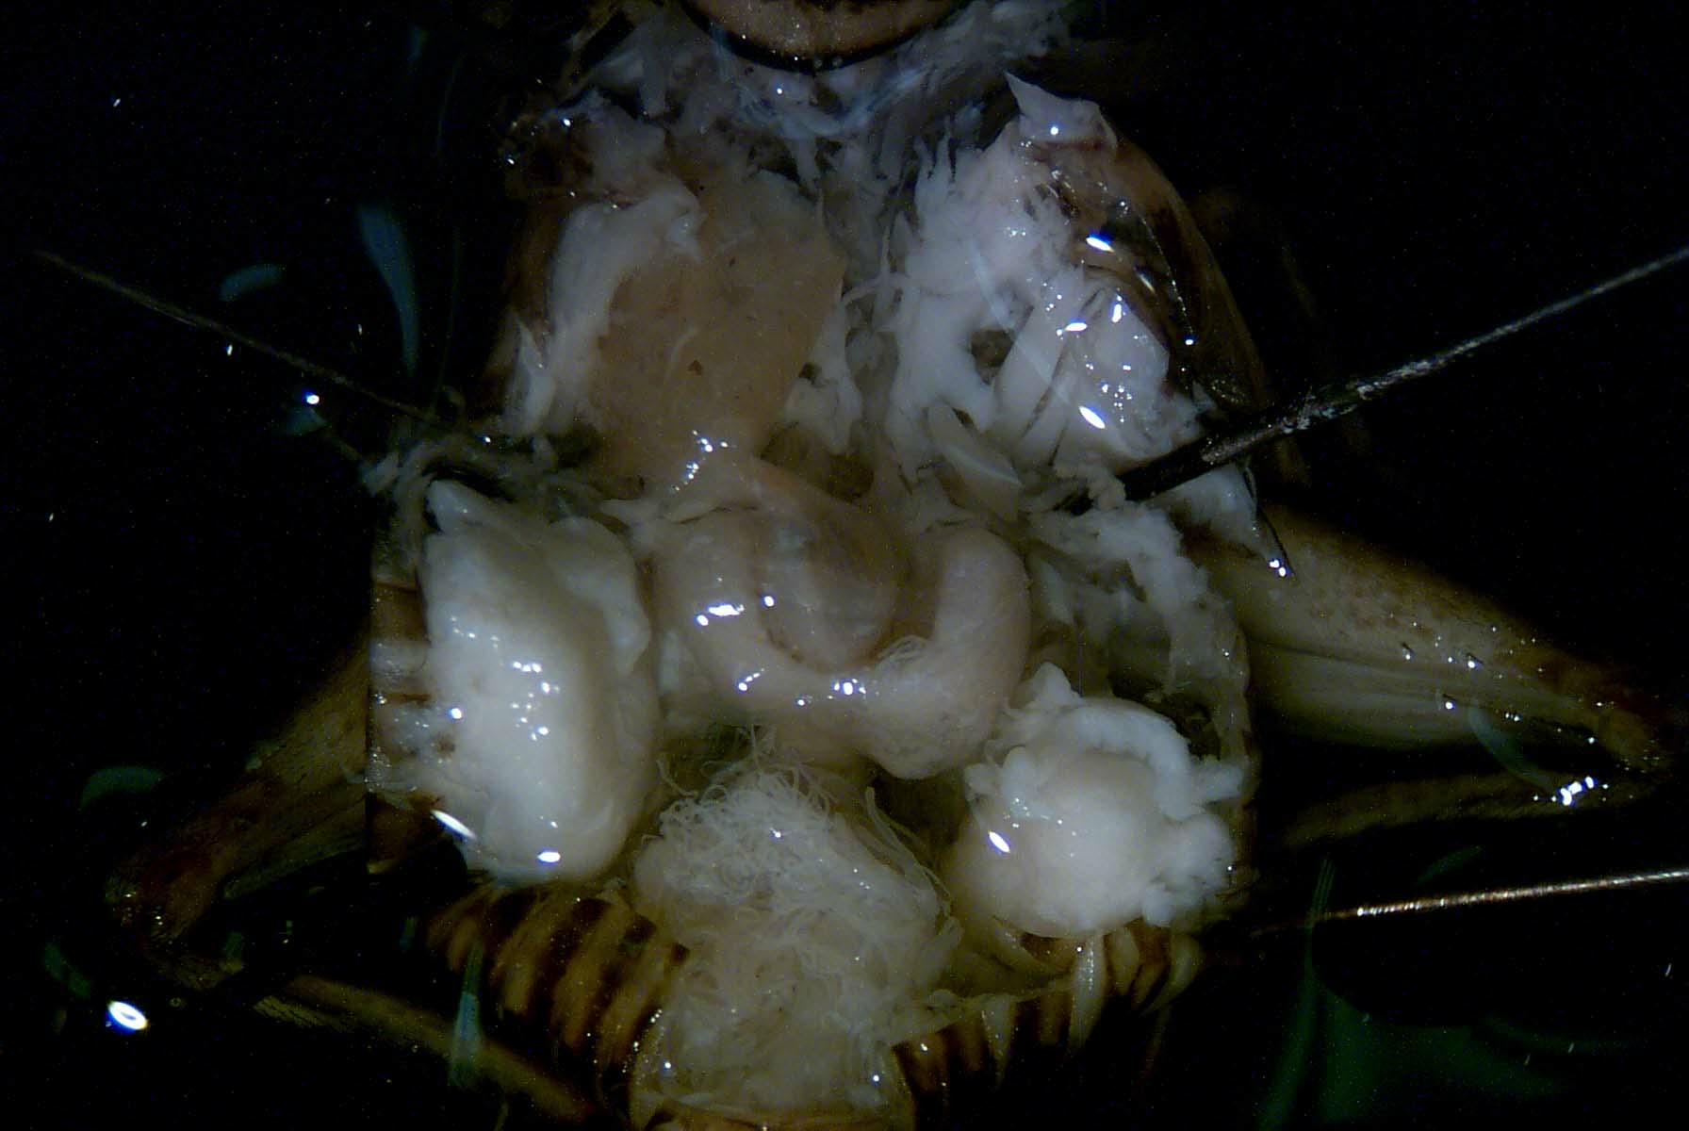
Don’t forget that the fore- and hind gut portions are from ectodermally derived tissues!
Inside a Grasshopper… Remember the baseball and glove?

Slide 26
Phylum Arthropoda, Subphylum Hexapoda,
Class Insecta, Order Orthoptera
Crop - storage
Proventriculus – grinding
= mechanical digestion
Gastric Caecum
- chemical digestion
Female has ovarioles
(looks like rice grains!)
Malpighian Tubules
- excretion
Respiratory system = Tracheal system (has spiracles etc.)

